Slide 1
QUANTUM PROCESSORS AND COMPUTING

Slide 2
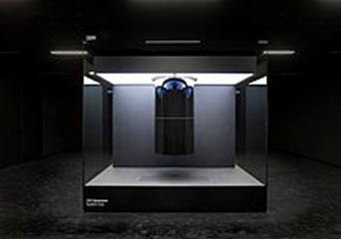
Quantum computing is a type of computation whose operations can harness the phenomena of quantum mechanics, such as superposition, interference, and entanglement. There are several models of quantum computation with the most widely used being quantum circuits. Other models include the quantum Turing machine, quantum annealing, and adiabatic quantum computation. In average quantum computers about 150 million times faster than supercomputers.
IBM Q System One (2019), the first circuit-based commercial quantum computer

Slide 3
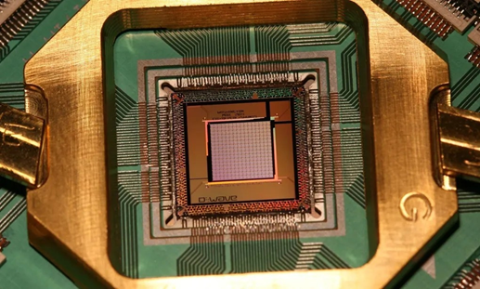
QUANTUM PROCESSOR AND QUBIT
Quantum computers have processors are based on the quantum bit, or "qubit", which is somewhat analogous to the bit in classical computation. A qubit can be in a 1 or 0 quantum state, or in a superposition of the 1 and 0 states. One model that does not use qubits is continuous variable quantum computation. Qubits are made using physical systems, such as the spin of an electron or the orientation of a photon. These systems can be in many different arrangements all at once, a property known as quantum superposition. Qubits can also be inextricably linked together using a phenomenon called quantum entanglement.

Slide 4
HISTORY OF QUANTUM COMPUTING
Quantum computing began in 1980 when physicist Paul Benioff proposed a quantum mechanical model of the Turing machine. Richard Feynman and Yuri Manin later suggested that a quantum computer had the potential to simulate things a classical computer could not feasibly do. In 1986 Feynman introduced an early version of the quantum circuit notation. In 1994, Peter Shor developed a quantum algorithm for finding the prime factors of an integer with the potential to decrypt RSA-encrypted communications. In 1998 Isaac Chuang, Neil Gershenfeld and Mark Kubinec created the first two-qubit quantum computer that could perform computations.

